Slide 1
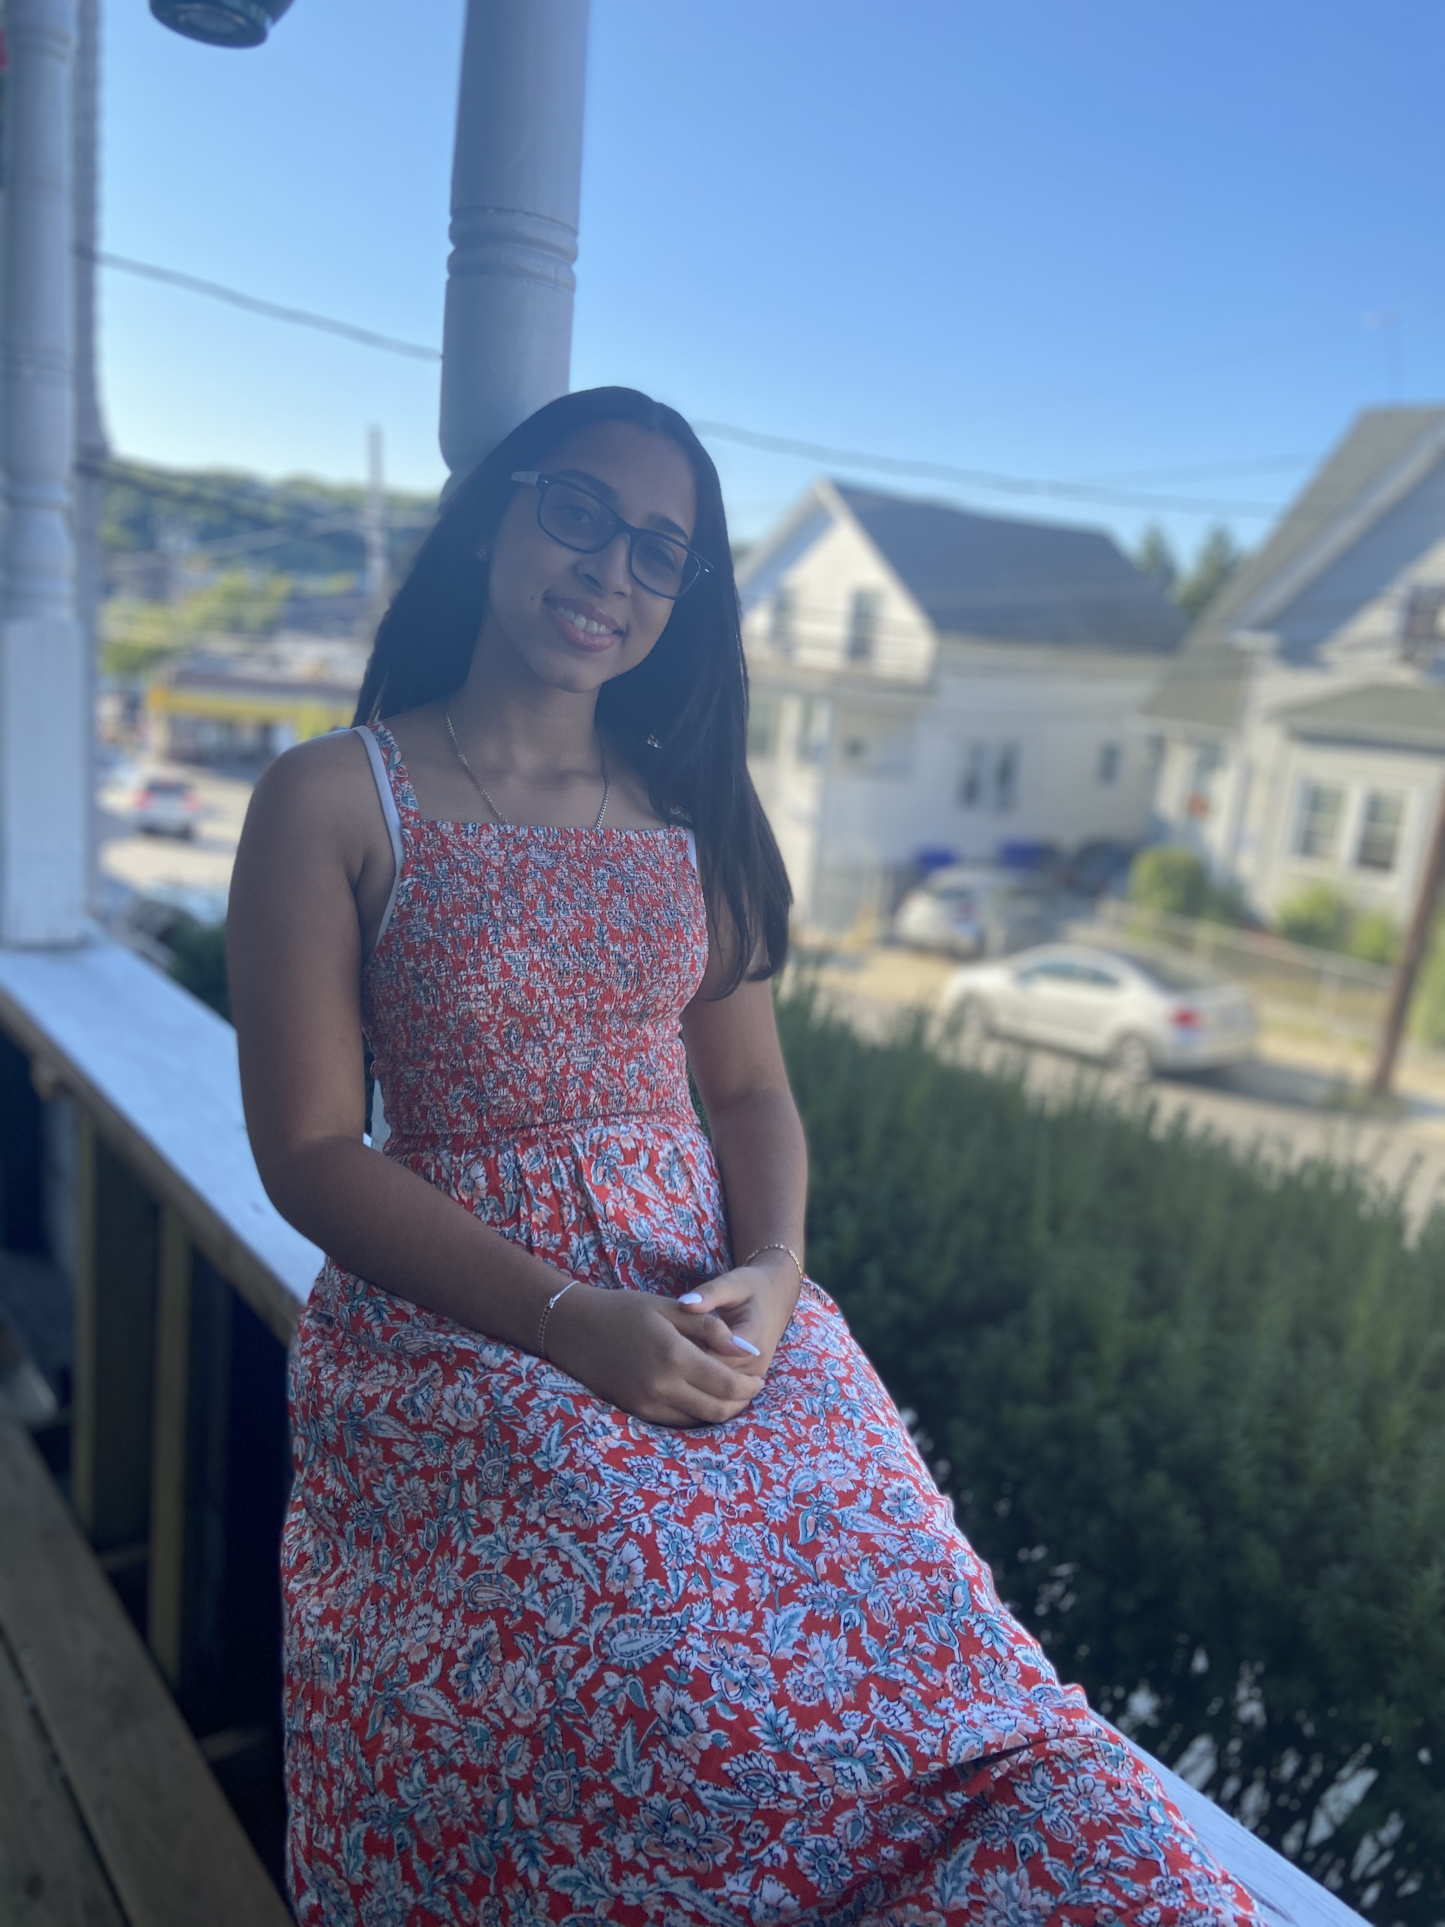
EMELY IS NOT ALONE
1.03
Emely's Story
My mother got her second dose a couple of weeks ago.
The symptoms were tough on my mom.
She decided it was best if I didn't get vaccinated, yet.
One reason was my mom's reaction to the second dose.
Another reason was all the misinformation people post online, as well as not being able to translate the true and false information.
Notes:
Good afternoon I'm Emely. Are you a parent whose been vaccinated? A couple of weeks ago my mother got her second dose. The second dose was tough on her. She had a lot of body ach, fever, and chills. Once she was better, she told me she didn't want me getting vaccinated yet. One reason she doesn't want me to get vaccinated was because of her reaction to the vaccine, but as many people know, it is different for everyone. Another major reason is all the misinformation people post online. Since my mom is not a fluent speaker in English, I tend to be her translator.

Slide 2
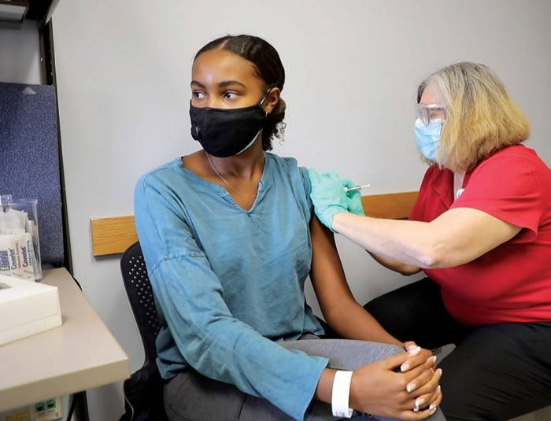
The Problem
1.03
How can we provide culturally linguistic and age-appropriate COVID-19 vaccine information to 12–15-year-old Hispanic children in Texas to improve vaccine acceptance?
j
Notes:
12–15-year-olds in the United States need access to up-to-date and accurate COVID-19 vaccine information in an engaging, fun way
12–15-year-olds recently became eligible for their vaccine
Parents may be hesitant to vaccinate their children
The information given to adults and parents should be different than that targeted to a younger audience
Children should have access to accurate information themselves versus only through a parent
There are almost 17 million Americans aged 12-15 (KFF statistic)
Children and parents may not know where to get vaccinated

Slide 3
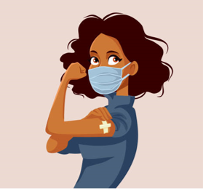
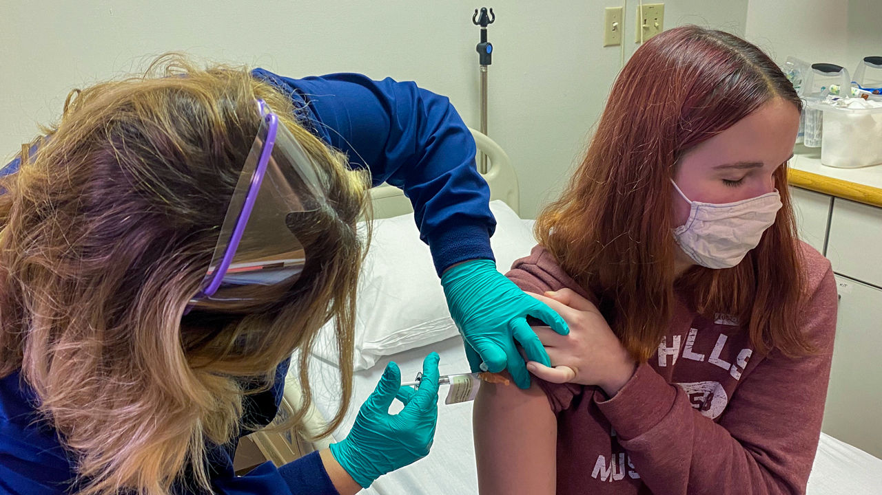
Educating with Facts
1.03
Hispanic persons have 2.3 times the death rate, as compared to White or Non-Hispanic Persons for COVID-19.
j
Notes:
Currently there are many sources spreading misinformation.
As a result, it remains difficult to find proper sources.
Here are some facts instead:
According to the CDC, Hispanic persons have experienced twice as many COVID-19 cases, three times the number of hospitalizations, and 2.3 times the death rate, as compared to White or Non-Hispanic Persons.
39.7% of the population in Texas is Hispanic (census.gov)
Kaiser Family Foundation: 30% of parents said they would get their child vaccinated.

Slide 4
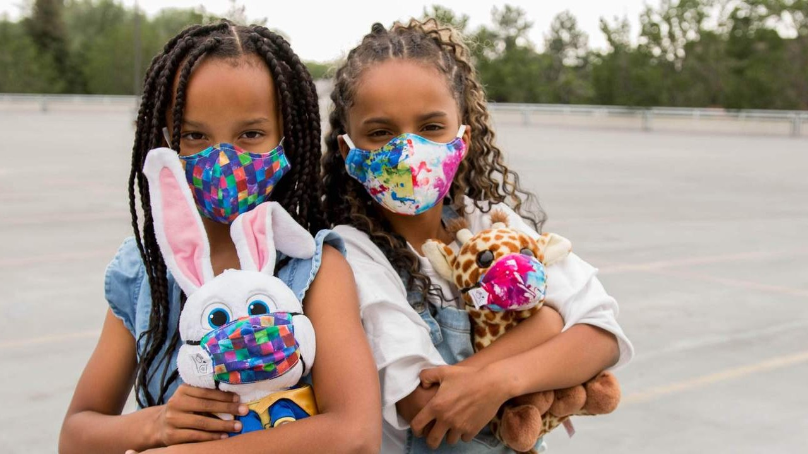
Currently Available Solutions
1.03
Children are getting their information from their parents
Subjective
Many resources are about children, but not directed to them
j
https://whyy.org/articles/when-will-kids-be-eligible-for-covid-19-vaccines-and-how-do-we-keep-them-safe-in-the-meantime/
Notes:
Children are currently getting vaccine information from:
Their Pediatrician
Friends
Parents
Social Media
Neighbors
These sources are often subjective, bias, or not up-to-date
Many resources are about children, but not directed to them

Slide 5
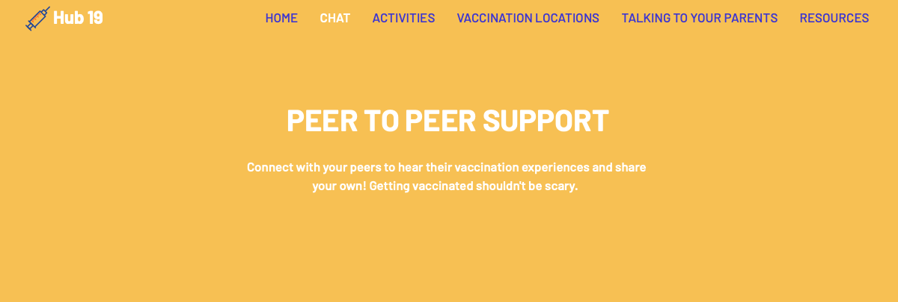
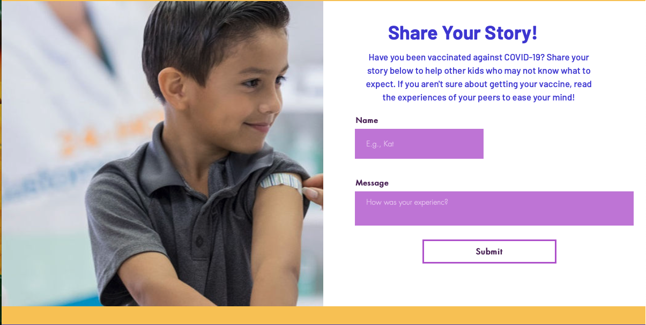
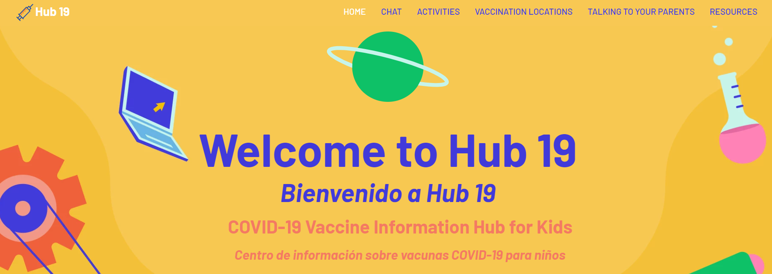
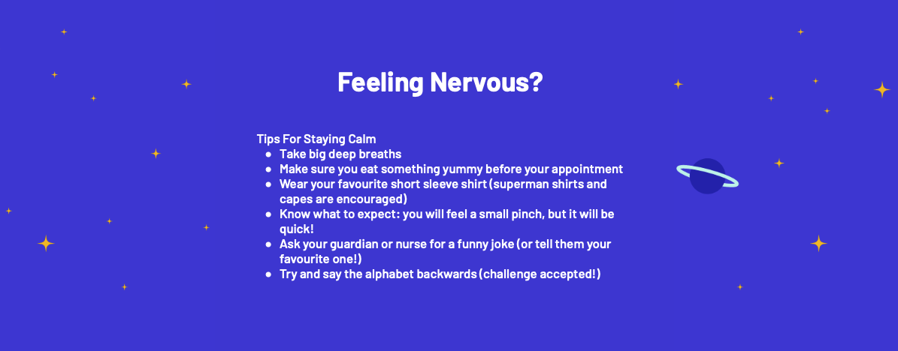
Our Solution
1.03
An interactive Tik Tok page along with a website targeted towards 12–15-year-old Hispanic children that provides reliable information about the COVID-19 vaccine.
Educate, Empower, Support
Notes:
An interactive website targeted towards 12–15-year-old Hispanic children that provides reliable information about the COVID-19 vaccine
Educate, Empower, Support
Features of the website include:
Peer-to-peer support
Tips for vaccine anxiety
Locations to get vaccinated
Speak to any regulations surrounding this solution or barriers you may encounter, but have a plan
Games
Ask the Expert forum

Slide 6
Business Model/Plan
1.03
Business Feature | Plan
Cost | Instagram Advertising: $0.50-$0.95 per click TikTok Advertising: $500 per 50, 000 views Website Domain Name: $5-$10 per month
Business Type | Non-Profit Run with grants from various health organizations and donations
Cost Savings | Preventing future hospitalizations, job losses, deaths, long haul covid 2.7 billion in excess health care spending 5 billion lost productivity Death Prevention – PRICELESS $$$$$$$$$
Partnerships | Community Partners Organizations (J&J, school nurses, National PTA, etc.)

Slide 7



Next Steps
1.03
Scaling the website to reach a wider range of youth
Connecting with local organizations for grants and support
Advertising on social media via influencers
j
This Photo by Unknown author is licensed under CC BY-SA-NC.
Notes:
Scaling the website to reach a wider range of youth
Expanding the scope of the website
Sexual health and education
Nutrition & Exercise
Mental Health
Other vaccines
Connecting with local organizations for grants and support
Advertising on social media via influencers, specifically targeting 12-15-year-olds

Slide 8
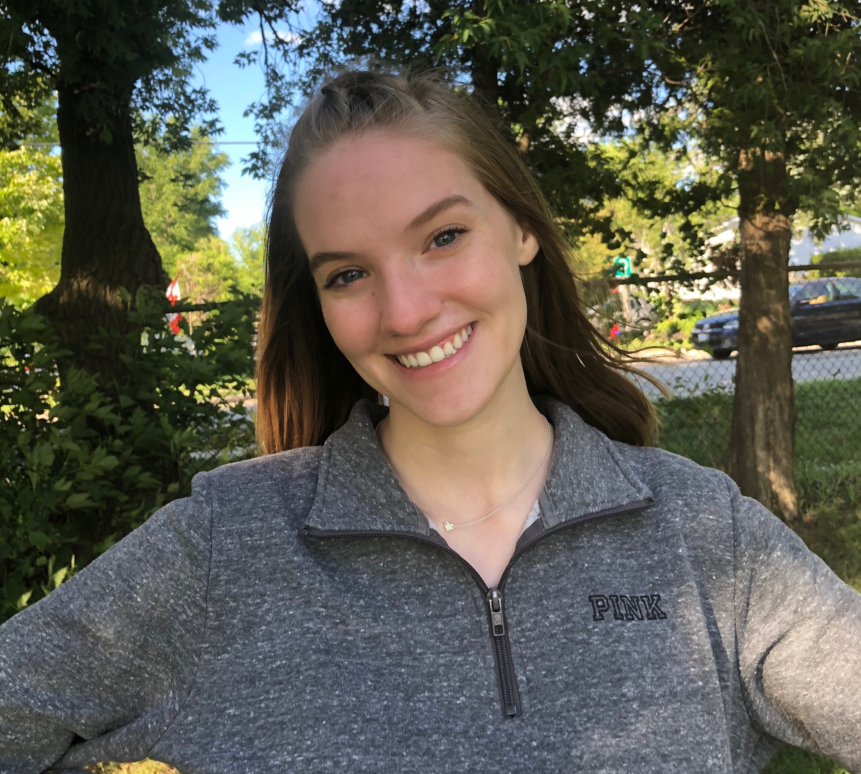
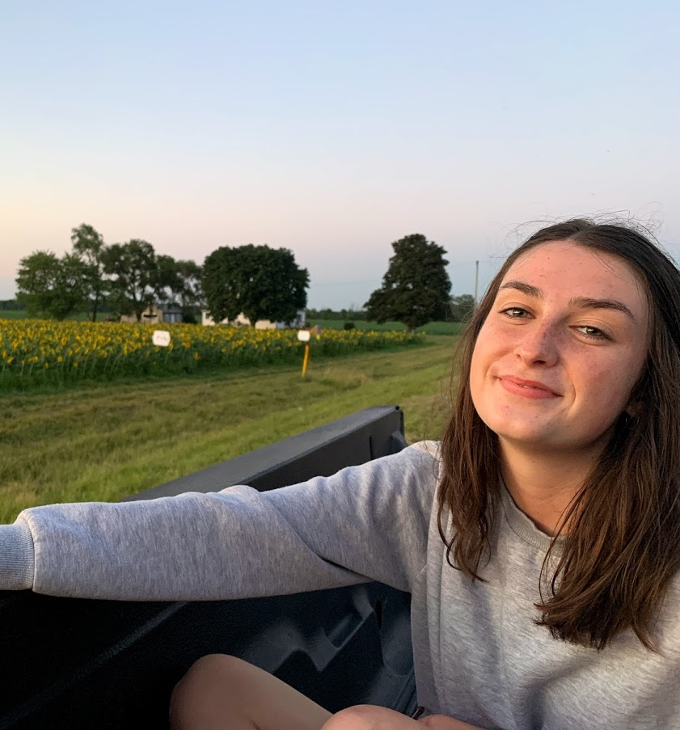
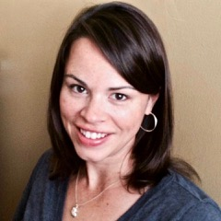
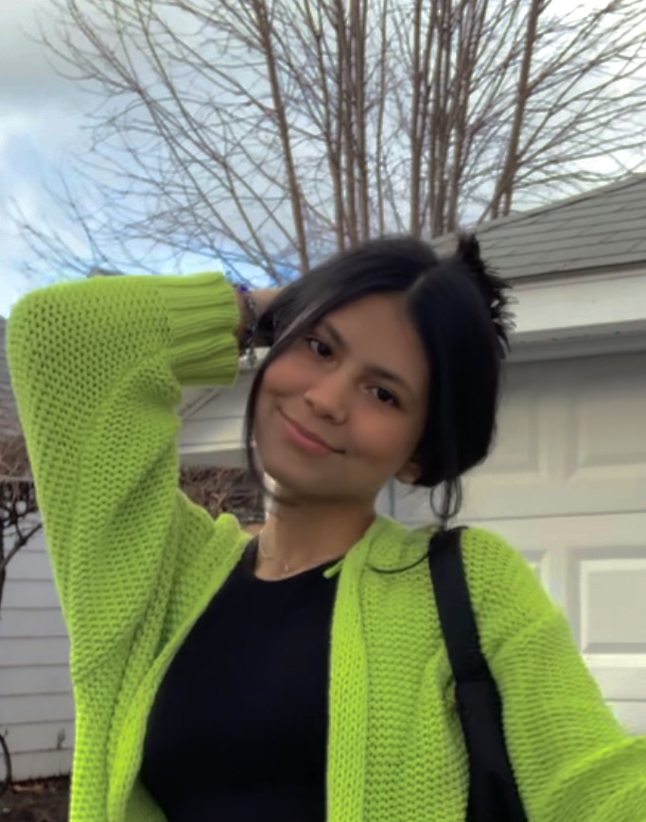
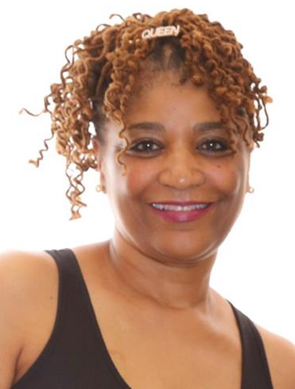
1.03
Misinformation Soldiers
Beth Mitchell
Laura Vancer
Susan Kelly BSN, RN
Maria Paula Narvaez Cano
Emely Padilla Duran
Trinna Kirkland DNP

